Slide 1

VANARSDEL’S SALES REPORT

Slide 2
SALES PERFORMANCE OVERVIEW
1

Slide 3
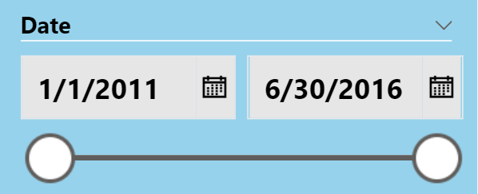
$ 65,55M
$ 17,7M
27%
Total Revenue
Total Profits
Profit Margin

Slide 4
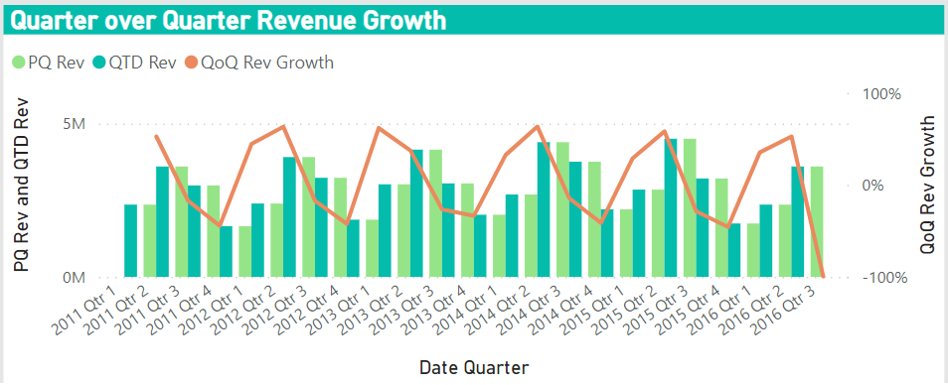
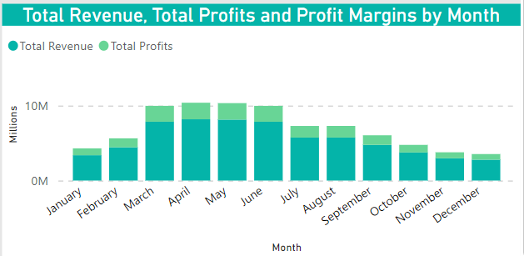
Product sales rises in the 1st quarter, reaches a peak in the 2nd quarter and then declines gradually during the latter half of the year. More than 60% of the total revenue comes from orders placed between march and June.

Slide 5
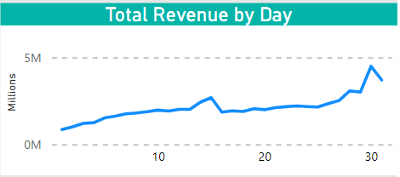
Sales value hits the highest level around the middle and at the end of month

Slide 6
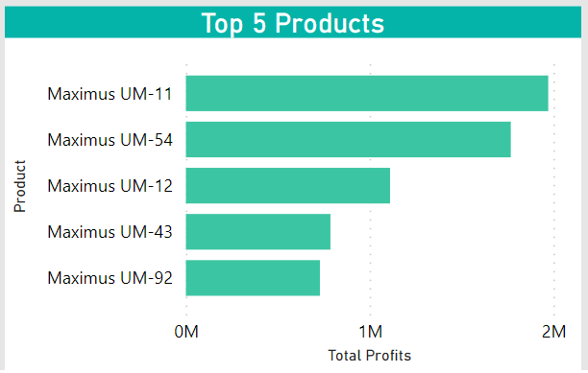
TOP 5 BEST SELLING PRODUCTS

Slide 7
SALES PERFORMANCE BY CAMPAIGN
TRAFFIC CHANNEL
Organic Search is the most profitable traffic channel, followed by SMO and SEM
DEVICE
The majority of purchase orders is made on desktop (33,98%), tablet (30,7%) and mobile (29,32%)

Slide 8
SALES PERFORMANCE BY CATEGORY & REGION
CATEGORY
83% Total revenue comes from Urban Category, with Moderation and Convenient are the 2 best selling segment.
REGION
47% of VanArsdel’s customers come from East America, contributing 30,9 million dollars to the total revenue. 36,7% customers are from Central America and only 16,3% are from the West.

Slide 9
BUDGET & FORECAST
2

Slide 10

In the 1st and 2nd quarter of 2016, VanArsdel’s sales reached 5.96M, which is
-0.71% lower than the forecasted value.
The target revenue for the later half of 2016 is 5.03M
The actual total cost is always within the projected budget

